Slide 1
1. Peter is considering switching he current phone plan to Tower Phone Company which charges a monthly service fee of $25 and 5 cents for every call he makes.
Define two variables and write an equation to represent the phone plan.
Let C = the monthly cost of Peter’s phone usage
n = the number of calls Peter makes in any month
C = 25 + 0.05n
b) Construct a linear graph to represent this situation.
c) Peter’s current phone plan does not charge monthly service fee but he pays 25 cents for every call he makes. Write an equation to represent his current phone plan using the variables you have defined.
C = 0.25n
d) Construct the linear graph for this plan on the same set of axes.

Slide 2
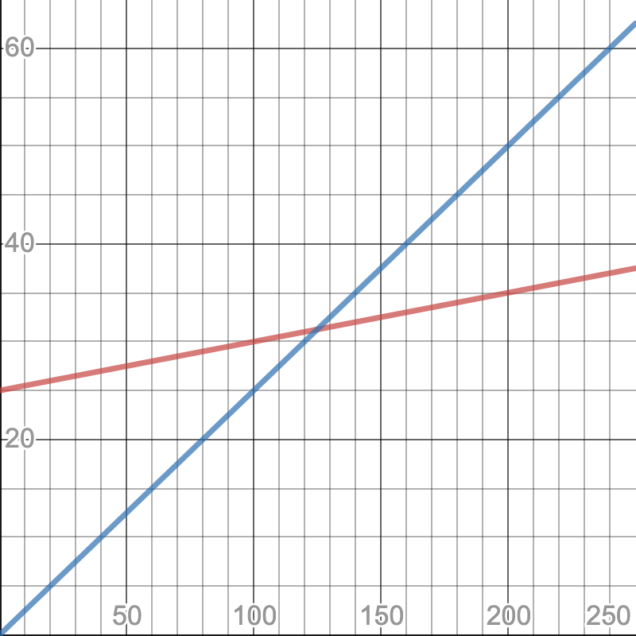
C ($)
C = 0.25n
C = 25 + 0.05n
n

Slide 3
e) Using the graph you have constructed, explain if it is good idea for Peter to switch his phone plan.
If Peter makes less than 125 calls a month, stay with the current plan because it is cheaper
If he makes exactly 125 calls a month, the cost is the same for both plan ($31.25)
If he makes more than 125 calls a month, then switch his plan to Tower Phone Company because it will be cheaper

Slide 4
2. Two families went to the theatre. The first family bought three adults tickets and five children tickets for $73.50 while the second family bought two adults tickets and three children tickets and paid $46.50.
Construct two simultaneous equations which can be used to determine the cost of each type of tickets.
Let A = the cost of an adults ticket
C = the cost of a children ticket
3A + 5C = 73.50
2A + 3C = 46.50
b) Hence, determine the cost of an adults ticket and the cost of a children ticket.
The cost of an adults ticket is $12.00 and the cost of a children ticket is $7.50

